Slide 1


COLLEGE EVENT MANAGEMENT
MONIKA SRIE K - 2303811714822021

Slide 2

ABSTRACT
Efficient coordination between students and faculty
Simplifies event planning and reduces manual effort
Real-time registration and resource tracking
Automatic report generation and Instant notifications

Slide 3
INTRODUCTION
The system helps in organizing and managing college events efficiently.
It stores and handles event details, registrations, and schedules.
Automates tasks like ticketing, attendee tracking, and notifications.
Reduces manual workload and minimizes errors .
Ensures secure access for students, faculty, and administrators.

Slide 4
PROPOSED ARCHITECTURE
College Event Management System
User Interface
Admin Panel
Event Mgt.
Module
Registration & Tracking;
Resource Mgt.
Module
Notification
Module
Report Gen.
Module
Database
( MySql )

Slide 5
PROPOSED EXPLANATION ADVANTAGES
Reduces manual work for organizers
Ensures better planning with fewer errors
Transparent and centralized system
Easy reporting for faculty and admin

Slide 6
MODULES
Event Management Module
Student Registration Module
Registered Student Viewer Module
Report Generation Module
Database Management Module
Dashboard Module Module

Slide 7
EXPLANATION OF MODULES
Event Management – create new events and update / delete existing events.
Student Registration – Students views available events, registered events saved in database.
Registered Student Viewer – Admin/Faculty view list of registered students.
Report Generation – Generate reports data as CSV file.
Database Management – MySql used to store: Users(student/faculty/admin), Events, Registrations.
Dashboard Module – Custom dashboard view for Students (List of open events) and Faculty/Admin (edit/delete/export).
.

Slide 8
PROGRAM
import sqlite3
from tkinter import *
from tkinter import messagebox
# Connect to SQLite database (creates if not exists)
conn = sqlite3.connect('college_events.db')
cursor = conn.cursor()
# Create events table
cursor.execute('''
CREATE TABLE IF NOT EXISTS events (
id INTEGER PRIMARY KEY AUTOINCREMENT,
title TEXT NOT NULL,
date TEXT NOT NULL,
venue TEXT NOT NULL,
description TEXT
)
''')

Slide 9
.
conn.commit()
# Function to add new event
def add_event():
title = entry_title.get()
date = entry_date.get()
venue = entry_venue.get()
description = text_desc.get("1.0", END).strip()
if title and date and venue:
cursor.execute("INSERT INTO events (title, date, venue, description) VALUES (?, ?, ?, ?)",
(title, date, venue, description))
conn.commit()
messagebox.showinfo("Success", "Event added successfully.")
clear_fields()
load_events()

Slide 10
.
else:
messagebox.showwarning("Missing Info", "All fields except description are required.")
# Function to delete selected event
def delete_event():
selected = listbox_events.get(ACTIVE)
if selected:
event_id = selected.split(' ')[0]
cursor.execute("DELETE FROM events WHERE id = ?", (event_id,))
conn.commit()
load_events()
messagebox.showinfo("Deleted", "Event deleted.")
else:
messagebox.showwarning("Select Event", "No event selected.")

Slide 11
.
# Function to show all events
def load_events():
listbox_events.delete(0, END)
cursor.execute("SELECT * FROM events")
for row in cursor.fetchall():
listbox_events.insert(END, f"{row[0]} - {row[1]} on {row[2]} at {row[3]}")
# Clear input fields
def clear_fields():
entry_title.delete(0, END)
entry_date.delete(0, END)
entry_venue.delete(0, END)
text_desc.delete("1.0", END)
# GUI layout using Tkinter
root = Tk()

Slide 12
.
root.title("College Event Management System")
Label(root, text="Event Title:").grid(row=0, column=0, sticky=E)
entry_title = Entry(root, width=40)
entry_title.grid(row=0, column=1, pady=5)
Label(root, text="Date (YYYY-MM-DD):").grid(row=1, column=0, sticky=E)
entry_date = Entry(root, width=40)
entry_date.grid(row=1, column=1, pady=5)
Label(root, text="Venue:").grid(row=2, column=0, sticky=E)
entry_venue = Entry(root, width=40)
entry_venue.grid(row=2, column=1, pady=5)

Slide 13
.
Label(root, text="Description:").grid(row=3, column=0, sticky=NE)
text_desc = Text(root, width=30, height=4)
text_desc.grid(row=3, column=1, pady=5)
Button(root, text="Add Event", command=add_event).grid(row=4, column=0, columnspan=2, pady=5)
listbox_events = Listbox(root, width=70)
listbox_events.grid(row=5, column=0, columnspan=2, pady=10)
Button(root, text="Delete Selected", command=delete_event).grid(row=6, column=0, columnspan=2)
load_events()
root.mainloop()
conn.close()

Slide 14
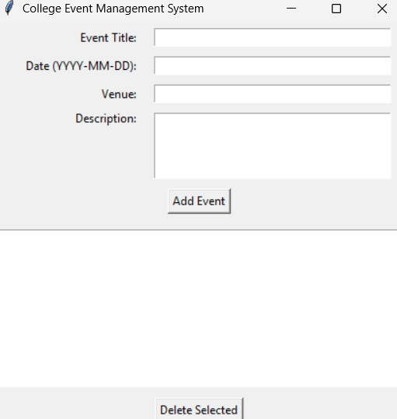
OUTPUT

Slide 15
Reference
1.MySQL Connector Python library for integrating Python with MySQL databases.
2. W3Schools tutorials on Python-MySQL integration and basic SQL queries.
3. GeeksforGeeks tutorials for building GUI applications using Tkinter.
4. SQL syntax and commands reference used to create and manipulate event data.

Slide 16
THANK YOU !!!!

